Slide 1
Introduction to Orchestration
Kubernetes

Slide 2
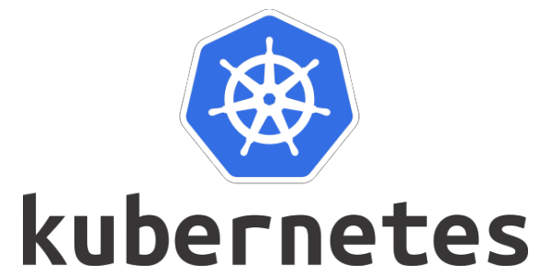
Kubernetes
Kubernetes, an open-source container orchestration platform, is designed to automate the deployment, scaling, and operation of application containers.

Slide 3
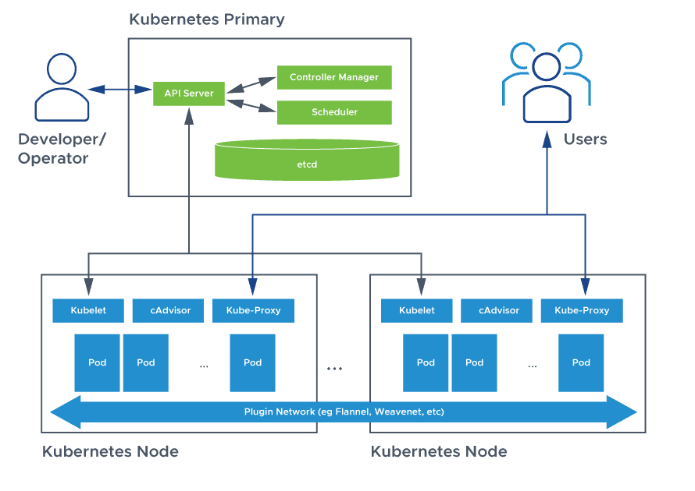
Kubernetes Architecture

Slide 4
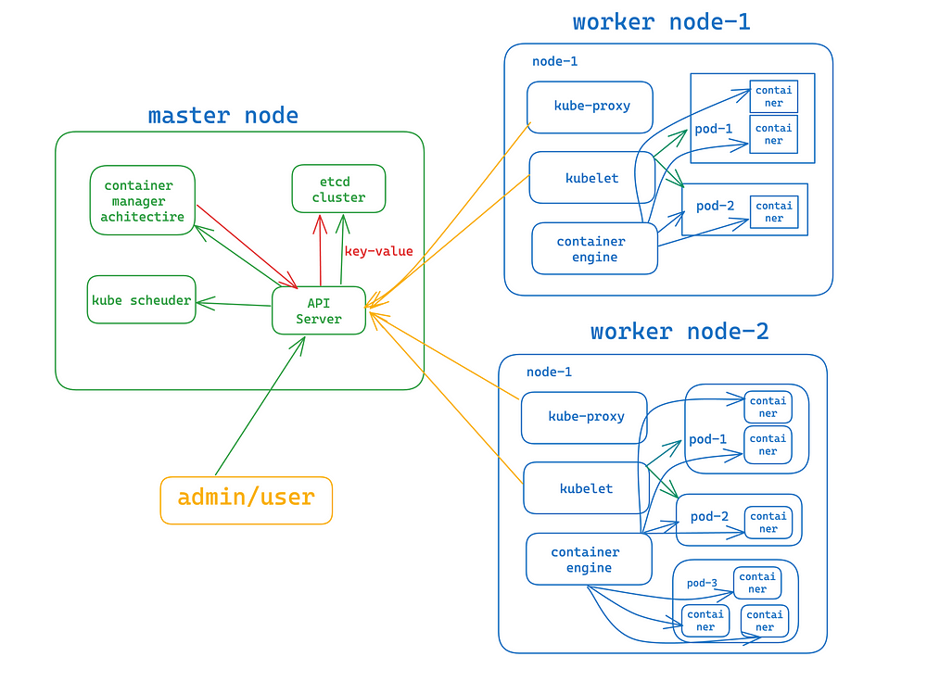
Cluster

Slide 5
Key Components
Master Node: Controls the cluster, responsible for the management of the Kubernetes cluster.
API Server: The front-end for the Kubernetes control plane. It exposes the Kubernetes API, acting as the main management point for the cluster.
Scheduler: Assigns workloads to specific nodes based on resource availability and policies.
Controller Manager: Runs controller processes to regulate the state of the cluster, ensuring that the desired state matches the current state.
etcd: A consistent and highly-available key-value store used as Kubernetes' backing store for all cluster data.

Slide 6
Worker Nodes: Run containerized applications. Each node has the necessary services to run pods and is managed by the master node.
Kubelet: An agent that ensures containers are running in a pod. It communicates with the master node and manages the containers' lifecycle.
Kube-proxy: Maintains network rules on nodes, enabling communication to and from pods within the cluster.
Container Runtime: manages and runs components required to run containers
Pod: Represents a single instance of an application

Slide 7
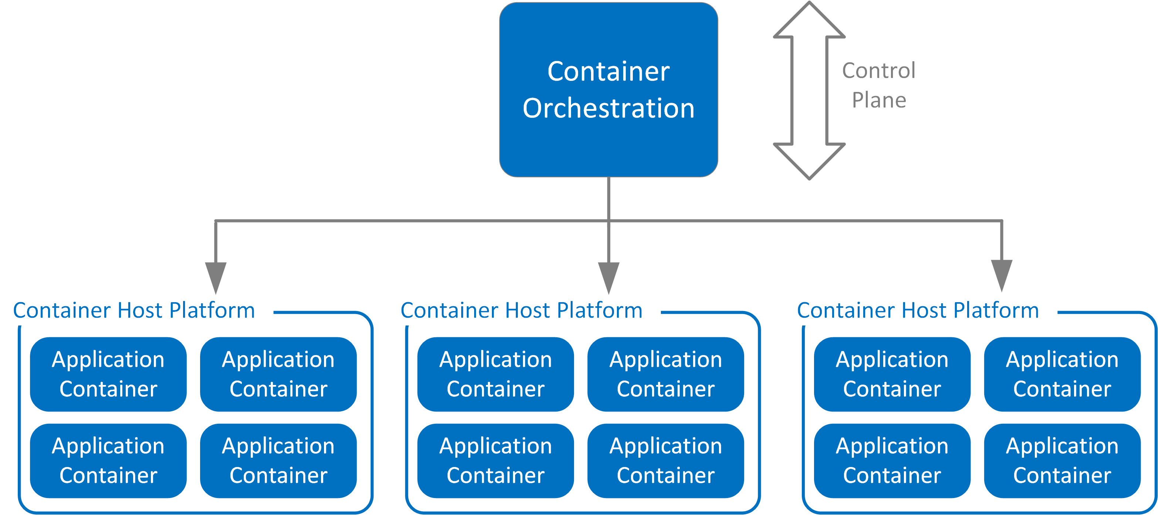
Container Orchestration

Slide 8
Kubernetes API
The Kubernetes API is a powerful interface that allows users to interact with and manage their Kubernetes clusters.
It provides a RESTful interface for querying and manipulating the state of various Kubernetes objects, such as pods, services, deployments, and more.

Slide 9
Key Features of Kubernetes API
Resource-Oriented Design:
The Kubernetes API is structured around resources, such as Pods, Services, Nodes, ConfigMaps, and more.
Each resource has a corresponding URL endpoint, allowing for operations like create, read, update, and delete (CRUD).
RESTful Endpoints:
The API uses standard HTTP verbs: GET (retrieve), POST (create), PUT (update), PATCH (partially update), DELETE (remove).
URLs are structured in a hierarchical format, e.g., /api/v1/namespaces/{namespace}/pods.

Slide 10
Key Features of Kubernetes API
API Versions:
The Kubernetes API is versioned to maintain compatibility. Common versions include v1, v1beta1, and v1alpha1.
Different API groups (e.g., core, apps, batch) may have different versions.

Slide 11
Common API Resources
Pods:
Smallest and simplest Kubernetes object, representing a single instance of a running process.
Services:
Abstract way to expose an application running on a set of Pods as a network service.
Deployments:
Provide declarative updates to applications, managing ReplicaSets to ensure the desired number of Pods are running.

Slide 12
Common API Resources
ConfigMaps:
Store configuration data in key-value pairs.
Secrets:
Store sensitive data, such as passwords, OAuth tokens, and SSH keys.
Nodes:
Represent a worker node in the cluster.

Slide 13
Interacting with the API
kubectl:
The primary command-line tool for interacting with the Kubernetes API.
Commands like kubectl get, kubectl create, kubectl delete, etc., interact with the API to manage resources.

Slide 14
Interacting with the API
Client Libraries:
Kubernetes provides client libraries for different programming languages (e.g., Go, Python, Java, JavaScript).
These libraries wrap the RESTful API calls, making it easier to programmatically interact with Kubernetes.
Direct HTTP Calls:
Users can make direct HTTP requests to the API server endpoints.
Authentication is required, typically using tokens, certificates, or other supported methods.

Slide 15
Creating and managing Cluster
Open portal.azure.com
Search for kubernates service
Create one kubernates cluster in US WEST 2 zone
Give the clustername like cluster1
Once the deployment is ready you can click on connect and connect either using powershell or bash

Slide 16
Check basic commands
On the master node, enter the following command to review cluster information:
kubectl cluster-info
On the master node, enter the following command to view complete cluster information
kubectl cluster-info dump
Use the following command to create a namespace:
kubectl create namespace firstnamespace

Slide 17
Confirm the creation of the new namespace with the following command:
kubectl get namespaces
To view the cluster configuration, use the command below:
kubectl config view
Run the following command to view the current cluster:
kubectl config current-context
To identify the API server, execute and copy the 127.0.0.1:8080 port as shown below:
kubectl proxy --port=8080

Slide 18
Activity: Managing working of Nodes
List all the running nodes in a cluster using the following command:
kubectl get nodes
Verify the status of the worker node you wish to inspect by running the following command:
kubectl describe node worker-node-1.example.com
Use the following command to delete a worker node:
kubectl delete node worker-node-1.example.com
Again check the running nodes

Slide 19
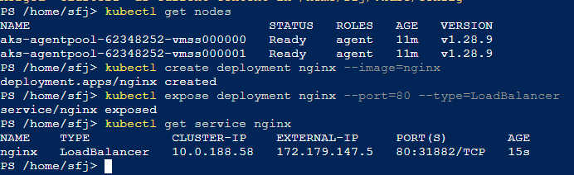
Create Deployment in Cluster
kubectl create deployment nginx --image=nginx
kubectl expose deployment nginx --port=80 --type=LoadBalancer
kubectl get service nginx

Slide 20
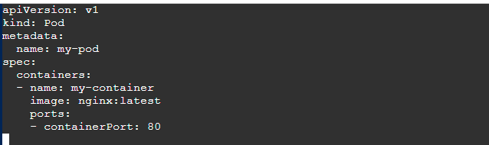
Configuring Pods in Cluster
Create YAML file: vi pod.yaml

Slide 21
Apply the updated Pod Definition YAML file:
kubectl apply -f my-pod.yaml
Verify the Pod is running:
kubectl get pods

Slide 22
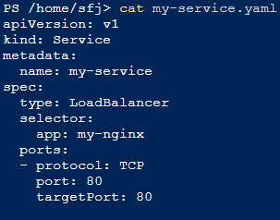
Kubernates Service
To access the Nginx container running in your AKS cluster, you can expose it using a Kubernetes service.
Create a file named my-service.yaml

Slide 23
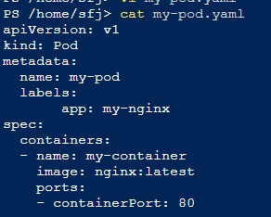
Modify the pod to match service
Update my-pod.yaml to include a label that matches the selector in the service.

Slide 24

Apply the updated Pod Definition YAML file
kubectl apply -f my-pod.yaml
Deploy the service to expose the pod:
kubectl apply -f my-service.yaml
Check service status:
kubectl get services
Copy external Ip address and check in browser for running service

Slide 25
Running Containers in Pods
A Pod is the smallest and simplest Kubernetes object.
It represents a single instance of a running process in your cluster.
Pods are designed to host one or more containers that share the same network namespace, storage, and specifications.
You run your application containers inside Pods.
Each Pod has its own IP address, and containers within a Pod can communicate with each other using localhost.
Pods can be created, destroyed, and recreated by Kubernetes, especially if part of a ReplicaSet, Deployment, or other higher-level abstraction.

Slide 26
Running Services in Pods
A Service in Kubernetes is an abstraction that defines a logical set of Pods and a policy by which to access them.
Services provide stable network endpoints to Pods, allowing you to expose your applications internally or externally.
Services are used to expose Pods to other Pods within the cluster, or to external users.
They can load balance traffic across multiple Pods.
Kubernetes supports several types of Services, including
ClusterIP
NodePort
LoadBalancer

Slide 27
Practical Use Case
Pods:
You deploy an application by creating Pods.
Services:
You expose the Nginx application to the internet or within the cluster by creating a Service that targets the Nginx Pod.
For example, deploying an Nginx server involves creating a Pod with an Nginx container.

Slide 28
Let’s Summarize
Pods run the actual application containers and manage their lifecycle
while Services provide stable network endpoints to access those Pods, handle load balancing, and expose the application to other components or external clients.

Slide 29
Deployment
A Deployment in Kubernetes is a higher-level abstraction that manages the lifecycle of Pods and ReplicaSets.

Slide 30
Deployment Features
Declarative Updates: You declare the desired state of your application, and the Deployment controller makes the necessary changes to achieve that state.
Scaling: Deployments allow you to scale the number of replicas of your application up or down.
Rolling Updates: You can update your application with zero downtime by rolling out updates incrementally.
Rollbacks: If an update causes issues, you can roll back to a previous stable state.
Self-Healing: If a Pod fails, the Deployment controller replaces it automatically.

Slide 31
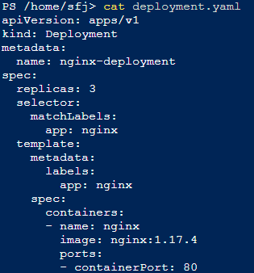
Creating and Configuring a Deployment
Create a Deployment YAML File:
Nano deployment.yaml

Slide 32
Apply the Deployment:
kubectl apply -f deployment.yaml
Verify the Deployment:
kubectl get deployments
kubectl get pods
Deployment entire Description
kubectl describe deployment nginx-deployment
Scaling the Deployment:
kubectl scale deployment/nginx-deployment --replicas=5
You can see the 5 replica running in deployment

Slide 33
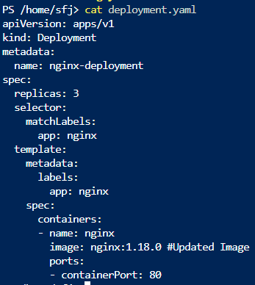
Update Deployment
changing the container image
modify the YAML file: nano deployment.yaml

Slide 34
Apply the updated YAML file:
kubectl apply -f deployment.yaml
Rolling Back a Deployment:
kubectl rollout undo deployment/nginx-deployment
Monitoring the deployment
kubectl rollout status deployment/nginx-deployment
Check the deployment description which will show the version rollbacked
kubectl describe deployment nginx-deployment

Slide 35
Create Deployment direct with image
Create an Nginx deployment
kubectl create deployment nginx --image=nginx
Expose the deployment as a service
kubectl expose deployment nginx --port=80 --type=LoadBalancer
Get the service details to find the ExternaIIP
kubectl get services
Copy paste the IP in browser and it will work

Slide 36
Activity: Create yaml file using command
Create Yaml file
kubectl create deployment myhttpd --image=docker.io/httpd --dry-run=client -o yaml > myapp1.yaml
Edit it you want update
Nano myapp1.yaml
Create Deployment
kubectl apply -f myapp1.yaml
Check the Deployments
Kubectl get deployments
Kubectl get pods

Slide 37
Expose the Service
kubectl expose deployment myhttpd --port=8080
Check service:
kubectl get svc
Describe the service
kubectl describe svc myhttpd

Slide 38
Activity: Create Deployment in namespace
Create Namespace
kubectl create namespace mynamespace
Verify namespace
kubectl get namespace
Create deployment in namespace
kubectl create deployment myapp1 --image=docker.io/httpd -n mynamespace
Get deployment of namespace
kubectl get deployment -n mynamespace

Slide 39
Activity: Create Deployment in namespace
Scale and verify the deployment by using the following commands:
kubectl scale --replicas=3 deployment myapp1 -n mynamespace
kubectl get deployment -n mynamespace
Retrieve the endpoints by using the following commands:
kubectl get endpoints
kubectl describe endpoints
Delete the deployment
kubectl delete deployment myapp1

Slide 40
Activity: Create Deployment in namespace
Delete the Service:
kubectl delete svc myapp1
Verify the deleted service
kubectl get svc
Delete namespace
kubectl delete namespace mynamespace
Verify events
kubectl get events
Verify the nodes state
kubectl get nodes
Describe the node configuration
kubectl describe node worker-node-1.example.com

Slide 41
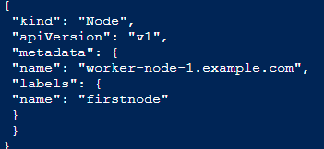
Create Node
Create node config file
vi nodereg.json

Slide 42
Create Node
Apply file for node creation:
kubectl create -f ./nodereg.json
Check created node
kubectl get nodes
To view node conditions, status
kubectl describe node worker-node-1.example.com

Slide 43
Taints
In Kubernetes, a "taint" is a property you can add to a node that prevents it from accepting any pods that do not tolerate the taint.
Taints and tolerations work together to ensure that pods are not scheduled onto inappropriate nodes.

Slide 44
Three Components of taints
Key: Identifies the taint.
Value: Provides additional context or specifics for the taint.
Effect: Specifies the action to take when a pod without the corresponding toleration is scheduled on the node. The possible effects are:
NoSchedule: Pods that do not tolerate this taint are not scheduled on the node.
PreferNoSchedule: Kubernetes will try to avoid scheduling pods that do not tolerate the taint on the node, but it is not a hard requirement.
NoExecute: Pods that do not tolerate this taint will be evicted from the node if they are already running there.

Slide 45
Taints
Taints and tolerations work together to ensure that pods are not scheduled onto inappropriate nodes. One or more taints are applied to a node; this marks that the node should not accept any pods that do not tolerate the taints
kubectl taint nodes node1 key1=value1:NoSchedule (Add taint)
kubectl taint nodes node1 key1=value1:NoSchedule- (Remove Taint)
Get taints on Node:
kubectl get nodes -o json | jq '.items[] | {name: .metadata.name, taints: .spec.taints}'

Slide 46
Understanding key value
When you create a taint, you can choose any key and value that make sense for your use case. The key typically represents the attribute you want to mark, and the value can provide additional context.
kubectl taint nodes <node-name> gpu=true:NoSchedule
key: gpu
value: true
effect: NoSchedule

Slide 47
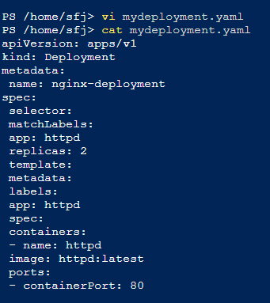
Activity: Launch a pod an establish service to pod

Slide 48
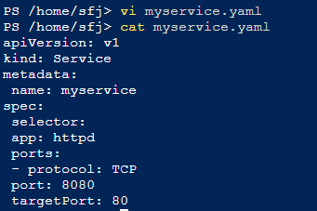
kubectl apply -f mydeployment.yaml
kubectl get deploymen
kubectl get pods

Slide 49
kubectl apply -f myservice.yaml
kubectl describe svc myservice
kubectl get pods -l app=httpd
kubectl get endpoints myservice

Slide 50
Backing Up and Restoring Etcd Cluster Data
Install the etcd-client using the command below: sudo apt install etcd-client
List all the pods in the kube-system namespace kubectl get pods -n kube-system
Describe the etcd pod in the kube-system namespace and note the IP
kubectl describe pods -n kube-system
After noting the client URL, set it as an environment variable and confirm its value
export advertise_url= <type client url>
echo $advertise_url

Slide 51
Back up the etcd data
sudo ETCDCTL_API=3 etcdctl \
Check the presence of the newly created etcd_backup.db file:
ls
Run the following command to verify the etcd backup:
sudo ETCDCTL_API=3 etcdctl \

Slide 52
Restore Data
Restore the etcd cluster data
sudo ETCDCTL_API=3 etcdctl \
Set the proper ownership for the new data directory
stat -c %U:%G /var/lib/etcd
sudo chown -R root:root /var/lib/etcd
Confirm the state of the cluster
sudo ETCDCTL_API=3 etcdctl endpoint health \

Slide 53
Configuring DNS for Kubernetes Services and Pods
To identify the core DNS deployment
kubectl get deploy coredns -n kube-system
To identify the coredns pods using selector:
kubectl get pods -l k8s-app=kube-dns -n kube-system
To identify the coredns service
kubectl get svc kube-dns -n kube-system
get endpoints:
kubectl get endpoints kube-dns -n kube-system

Slide 54
apiVersion: apps/v1
kind: Deployment
metadata:
name: my-nginx
spec:
selector:
matchLabels:
run: my-nginx
replicas: 2
template:
metadata:
labels:
run: my-nginx
spec:
containers:
- name: my-nginx
image: nginx
ports:
- containerPort: 80
describe the endpoints:
kubectl describe endpoints kube-dns -n kube-system
Execute DNS query: vi nginx.yaml

Slide 55
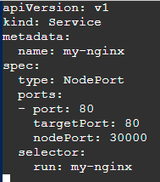
kubectl apply -f nginx.yaml
kubectl get deploy my-nginx
kubectl get pods -l run=my-nginx
Create Service: vi my-nginx-service.yaml
kubectl apply -f my-nginx-service.yaml

Slide 56
kubectl get svc my-nginx
kubectl get ep my-nginx
Create Curl pod to perform DNS query
kubectl run curl --image=radial/busyboxplus:curl -i --tty -- sh
nslookup google.com
nslookup my-nginx
nslookup my-nginx.default.svc.cluster.local (local cluster lookup)
curl my-nginx (you can see the entire code)
exit

Slide 57
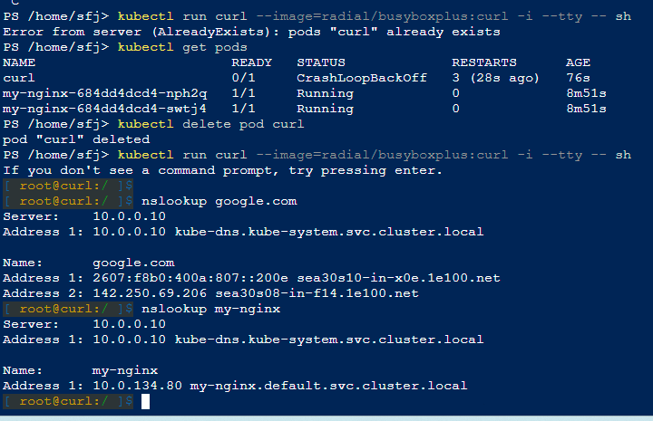

Slide 58
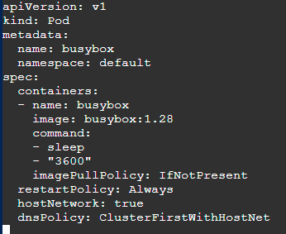
Configure DNS (vi dnspolicy.yaml )

Slide 59
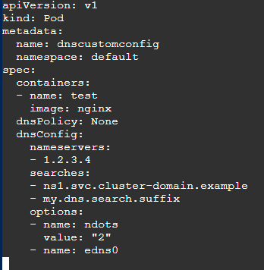
kubectl apply -f dnspolicy.yaml
kubectl get pods
kubectl describe pod busybox
Create a configuration YAML file:
vi dnsconfig.yaml
kubectl apply -f dnsconfig.yaml

Slide 60
Set up the IPv6 for the DNS connectivity:
kubectl exec -it dnscustomconfig -- cat /etc/resolv.conf

Slide 61
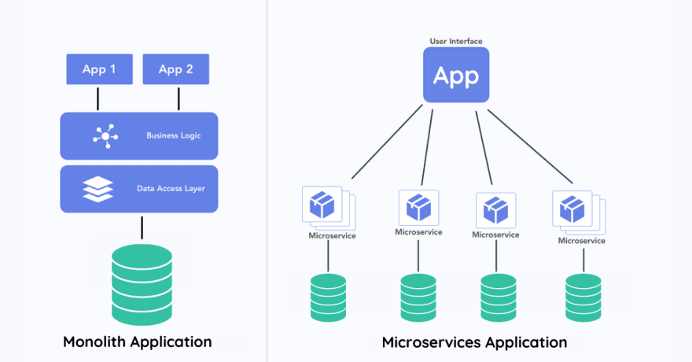
Monolith Vs Microservice

Slide 62
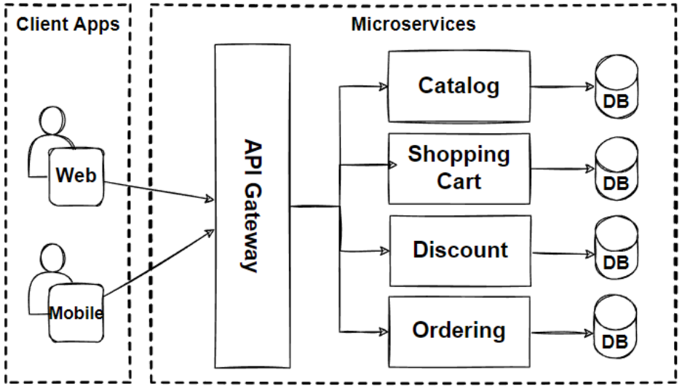
Microservices

